Slide 1
Time-Frequency Representations Part II
COMP.SGN.120
Introduction to Audio processing
Lecture 5

Slide 2
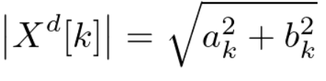
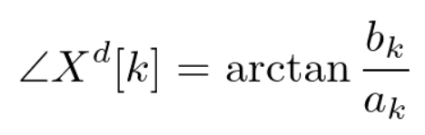
Recap DFT
DFT output is a complex number-based vector
Magnitude
Phase
Due to the mirror image characteristics of the DFT, our area of interest for each frame needs only half of the points.

Slide 3
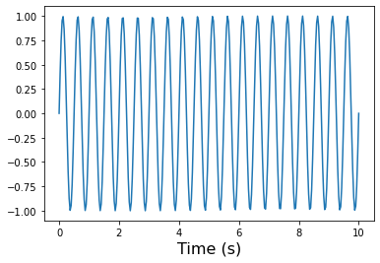
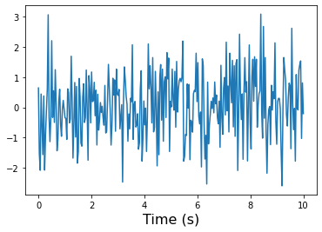
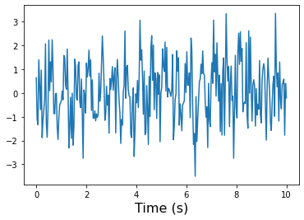
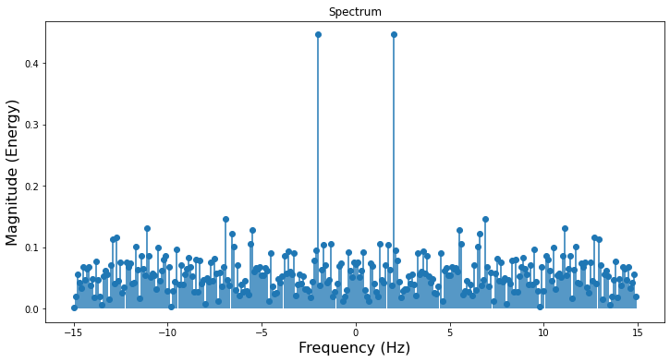
Spectrum
Magnitude spectrum: describes a signal using frequency and amplitude.
+
=
The frequencies range from negative to positive

Slide 4
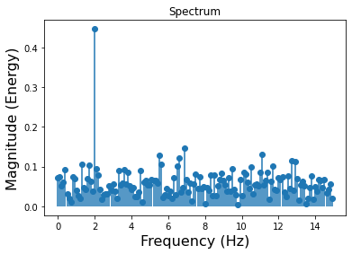
Spectrum
Usually, we represent only the positive ones.
X = fft(x)
magnitude = np.abs(X)[:len(x)//2]/len(x)
faxis = np.arange(len(X))*(fs/len(X))
Describes the signal as a function of frequency.
White noise: a signal where the average spectrum is flat.
Pink noise: a signal that has a spectrum with a 3-dB/octave decay towards high frequencies.

Slide 5
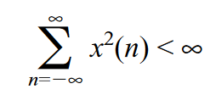
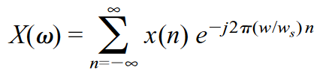
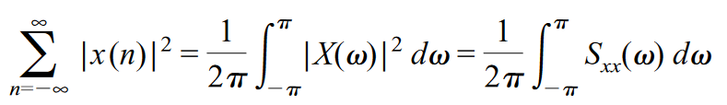
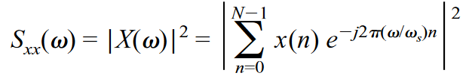
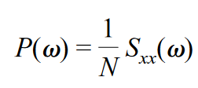
Power spectrum
Also known as Spectral power density.
It is not easy in practive due to the fact that we have limited set of simples of the signal.
Consider a sampled signal x(n), and assume that the signal has finite energy:
The DTFT is
Spectral density of the signal x(n)
The energy of the signal is
The power of the signal as a function of the frequency is:
The spectral density can be written as

Slide 6
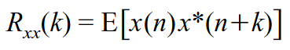
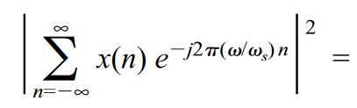
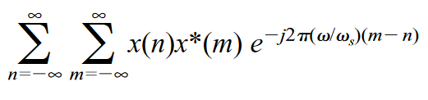
Power spectrum
Alternative estimate by using the auto-correlation function of the signal x(n)
For stationary signal the auto-correlation function is:
Where * denotes complex conjugate, and E[ ] is the expected mean operator.
The square magnitude of the Fourier transformed signal sequence x(n) is:

Slide 7
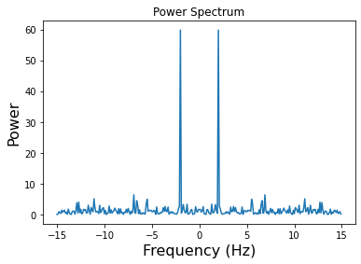
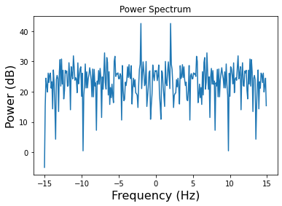
Power spectrum
Power of each frequency component.
It can be represented in linear scale or in log scale.
Sound power, sound source radiating energy along with the sound wave it creates.

Slide 8
Auditory spectrum
Psychoacoustic theory: describes the peripheral hearing system as a spectral analyser that extract several perceptual aspects (loudness, pitch, duration, sharpness, roughness).
Simplest model to imitate is the loudness perception.
An Auditory Spectrum can be derived which describes the level of cochlear excitation in dBs as function of frequency on the Equivalent Rectangular Bandwidth scale.

Slide 9
Computation of Auditory Spectrum
Selection of 25 ms time frames
Multiply by a window (E.g. Hamming)
Power spectrum computation. The DFT is applied to each frame (Using FFT)
FFT (Fast Fourier Transform) efficient way of calculating DFT, available in audio processing software.
The resolution when calculating DFT is equal to the sampling rate divided by the window size.

Slide 10
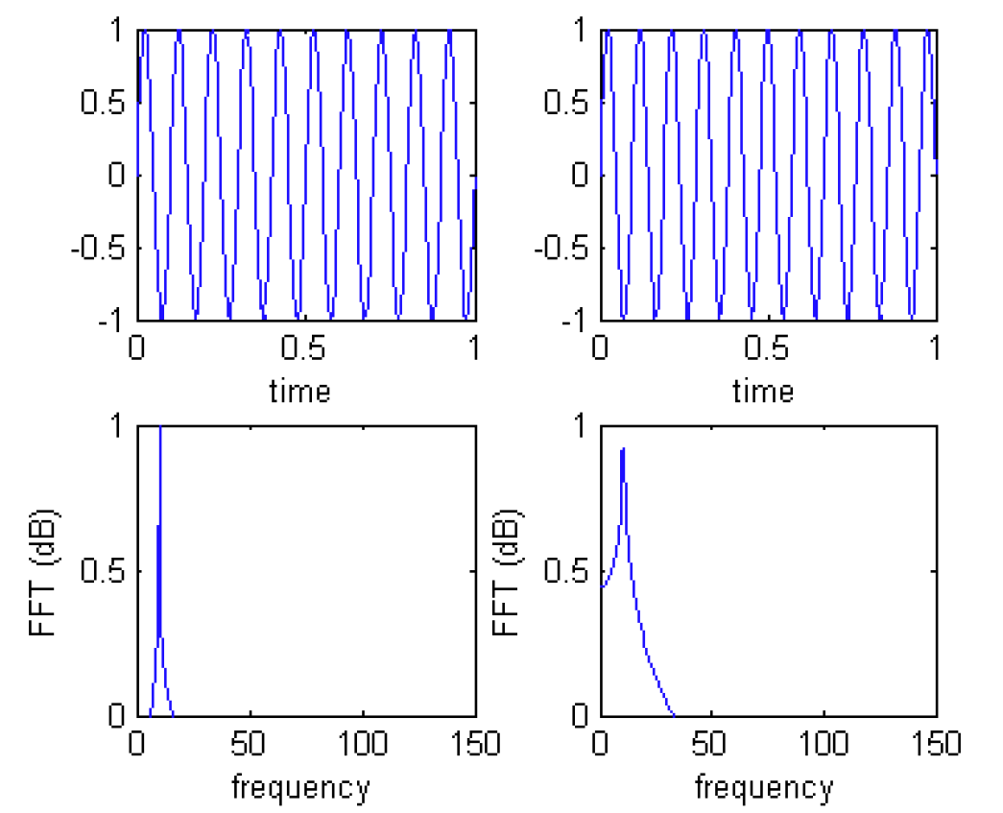
Windowing
DFT Assumes that the signals are periodic, the finite segment is a complete period from an infinite signal that repeats over all time.
Problem: discontinuity at the beginning and end of the segment.
If the end and beginning do not connect smoothly the discontinuity creates additional frequency components in the segment that are not in the signal. Spectral Leakage
The spectral energy “leaks” to the adjacent bins.

Slide 11
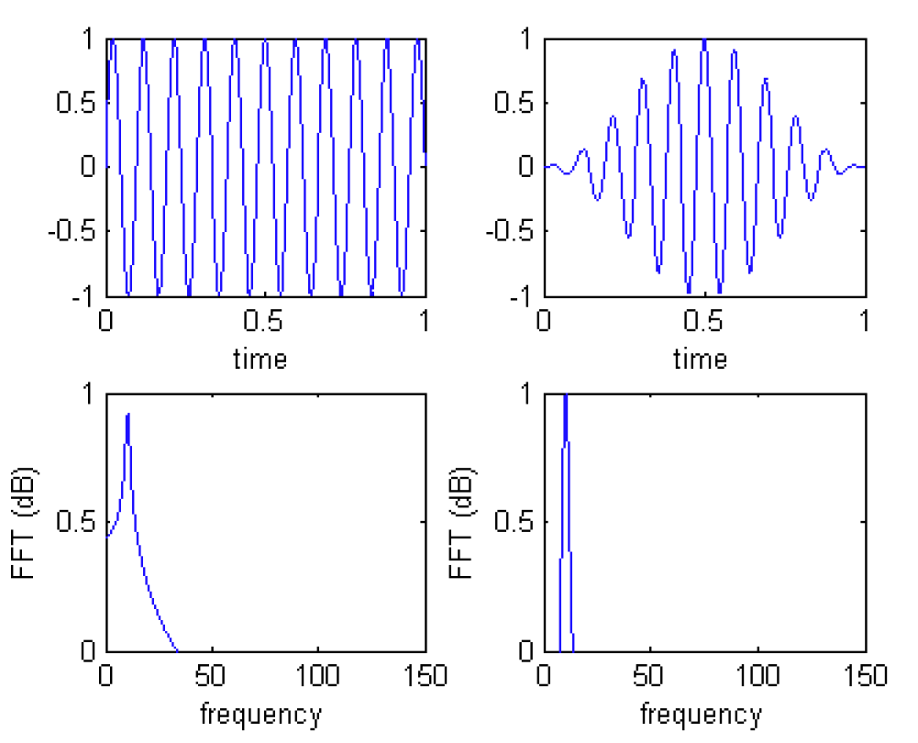
Windowing
When windowing is applied, the leakage is reduced in the FFT.
It minimizes the effect of the leakage to better represent the frequency spectrum of the data.
A window function transforms a non-periodic segment into something that can pass for periodic.
Reduces energy leaks to the adjacent spectral bins.
Widens the peaks, the leakage is confined to a narrower range.

Slide 12
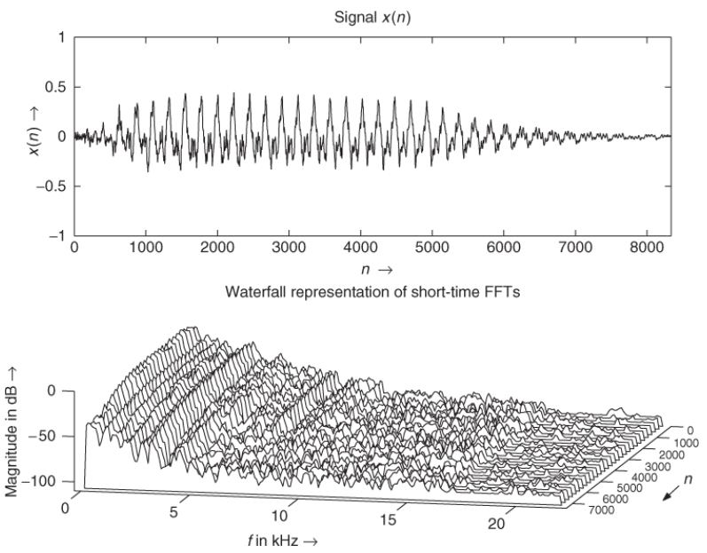
The Fast Fourier Transform (FFT)
DFT can be used with little to no wait-time due to Cooley and Tukey algorithm (1965)
It breaks the Fourier transform into smaller sub-transforms which require less computation.

Slide 13
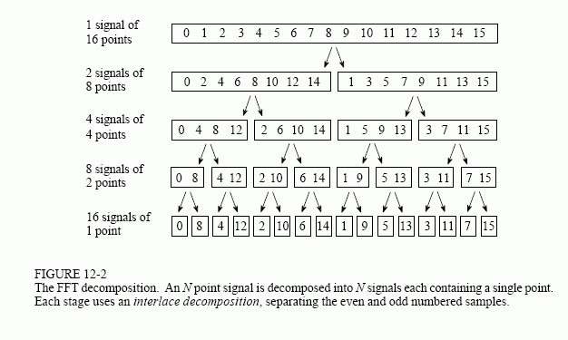
Fast Fourier Transform algorithm
Decompose an N point time domain signal into N time domain signals each composed of a single point.
Calculates the N frequency spectra
The N spectra are synthesized into a single frequency spectrum.
Symmetry properties (odd and even parts) are exploited in order to perform less computations for each sub-problem.

Slide 14
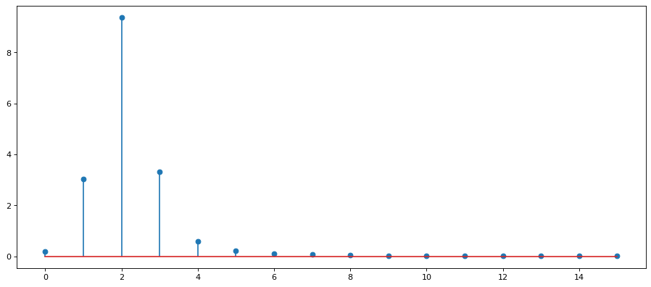
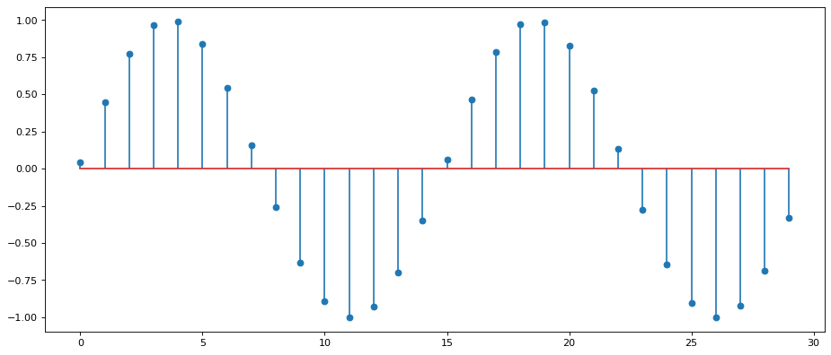
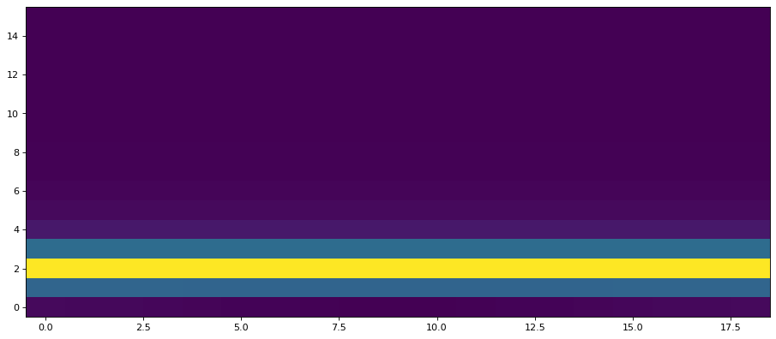
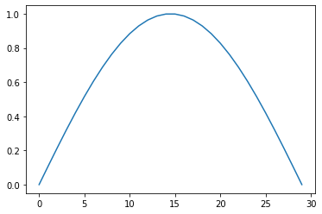
To sum up
3.
Select a frame
Apply a window
Calculate the power spectrum
Append to obtain the spectrogram
4.
1.
2.

Slide 15
Other transforms
DCT: audio coding algorithms

Slide 16
Discrete Cosine Transform (DCT)
Expresses a finite sequence of data points in terms of a sum of cosine functions oscillating at different frequencies
Similar to DFT (but DFT uses sines and cosines)
Fewer cosine functions are needed to approximate a typical signal
Makes it very useful in signal compression
DCTs are equivalent to DFTs of roughly twice the length, operating on real data with even symmetry (Fourier transform of a real and even function is real and even)
Four variants are common (eight in total)
DCT II - used in visual media standards (image compression JPEG, video compression MPEG, etc )
DCT IV or MDCT used in most audio standards, both general audio and speech (MP3, AAC, WMA, Vorbis, etc)

Slide 17
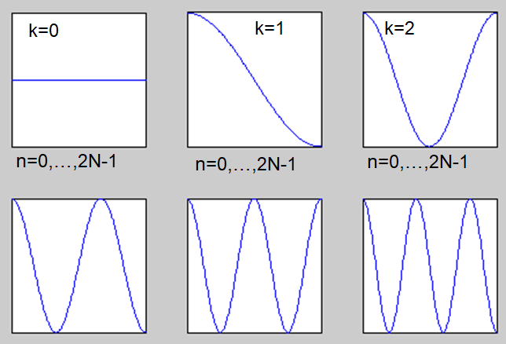
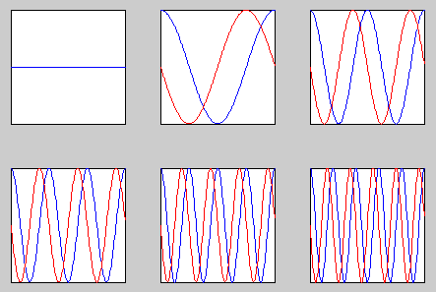
Discrete Cosine Transform
First few basis DCT functions (real-valued)
First few basis functions DFT (blue: real part, red: imaginary part)

Slide 18
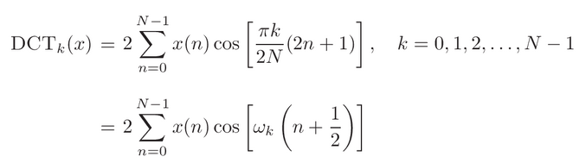
Discrete Cosine Transform
For 1D signals
DCT is normally implemented using the same basic efficiency techniques as in FFT algorithms.
Applications:
Speech signal compression

Slide 19
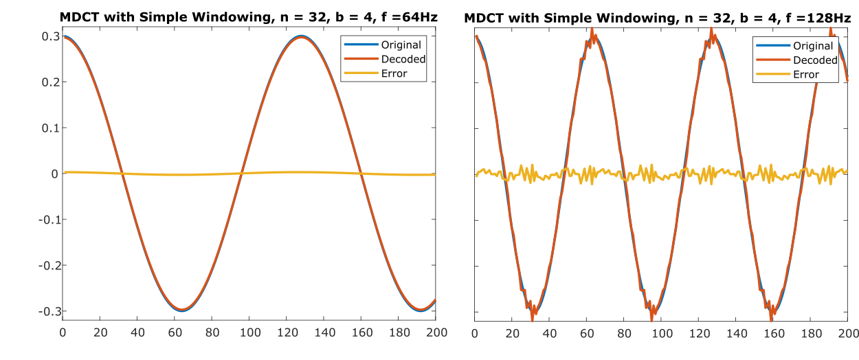

Modified discrete cosine transform (MDCT)
Lapped transform based on type-IV DCT
Subsequent blocks are overlapped so that the last half of one block coincides with the first half of the next block → helps to avoid artifacts stemming from the block boundaries
Has half as many outputs as inputs
2N real numbers x0, ..., x2N-1 are transformed into the N real numbers X0, ..., XN-1

Slide 20
Thinking break (2 minutes)

Slide 21
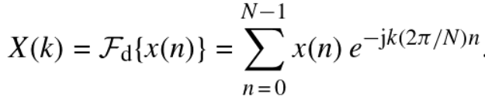
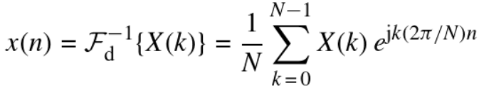
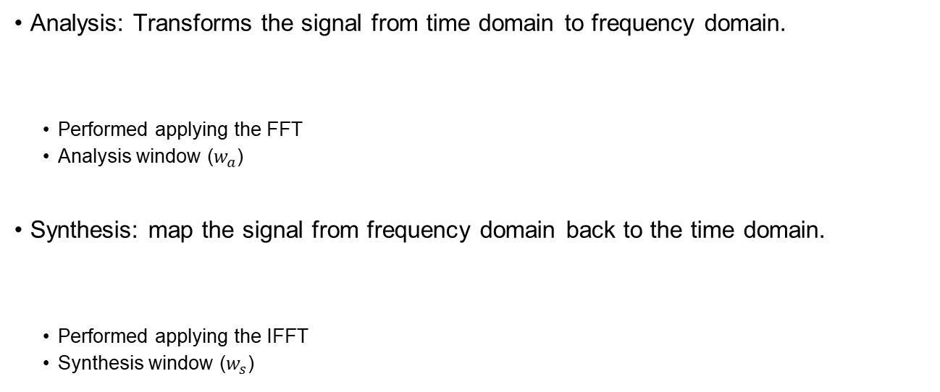
Fourier analysis and synthesis
Analysis: Transforms the signal from time domain to frequency domain.
Performed applying the FFT
Analysis window ($w_{a}$)
Synthesis: map the signal from frequency domain back to the time domain.
Performed applying the IFFT
Synthesis window ($w_{s}$)

Slide 22
Reconstruction of the signal
Done by using inverse trasform (IDFT)
Analysis part is not concerned about reconstruction:
Taking the inverse DFT of the STFT frames that do not overlap in time, the ends of the adjacent frames will not connect well.
Results in audible “ripple” distortion
Solution: have frames overlap
Window overlap-add processing:
Move the analysis window (e.g.) 50% of the window length forward
Apply analysis windowing
Take DFT
Process data (in frequency domain)
Take iDFT
Apply synthesis windowing.
Reconstruct a frame by summing with previous frame with overlap

Slide 23
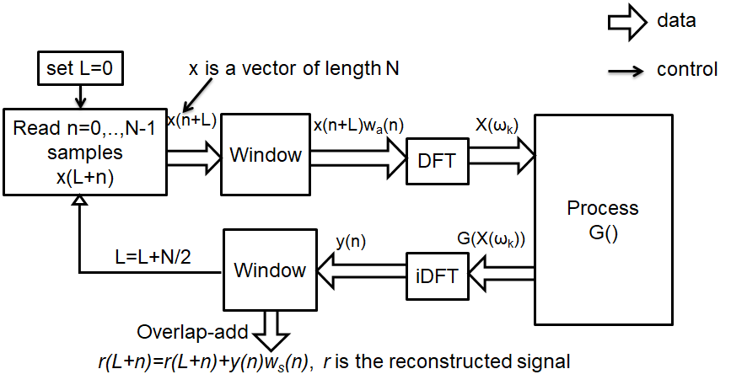
STFT and overlap-and-add processing

Slide 24
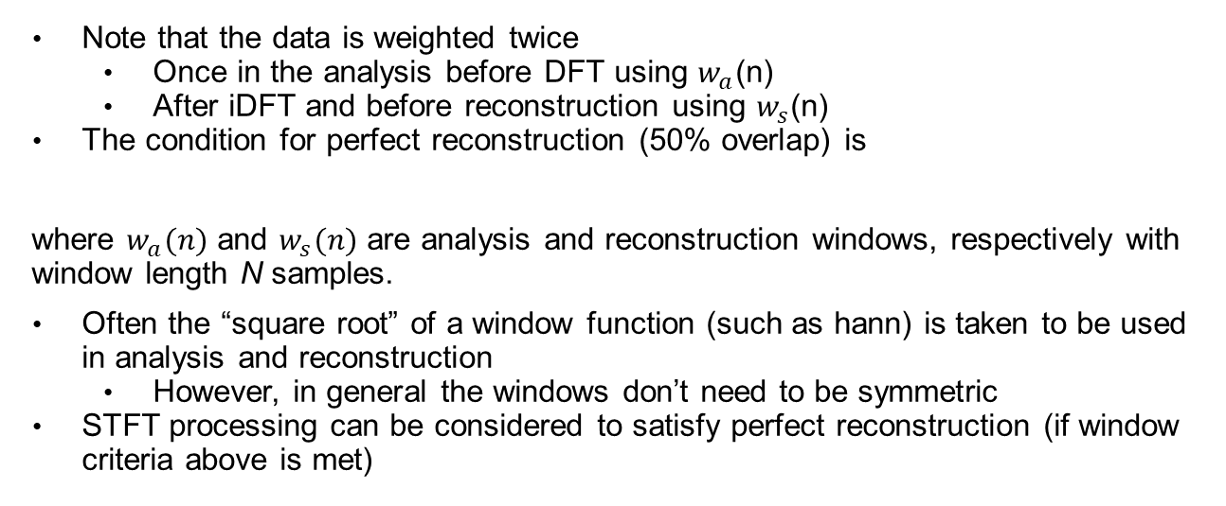
Overlap-and-add processing
Note that the data is weighted twice
Once in the analysis before DFT using $w_{a}$(n)
After iDFT and before reconstruction using $w_{s}$(n)
The condition for perfect reconstruction (50% overlap) is
where $w_{a}(n)$ and $w_{s}(n)$ are analysis and reconstruction windows, respectively with window length N samples.
Often the “square root” of a window function (such as hann) is taken to be used in analysis and reconstruction
However, in general the windows don’t need to be symmetric
STFT processing can be considered to satisfy perfect reconstruction (if window criteria above is met)

Slide 25
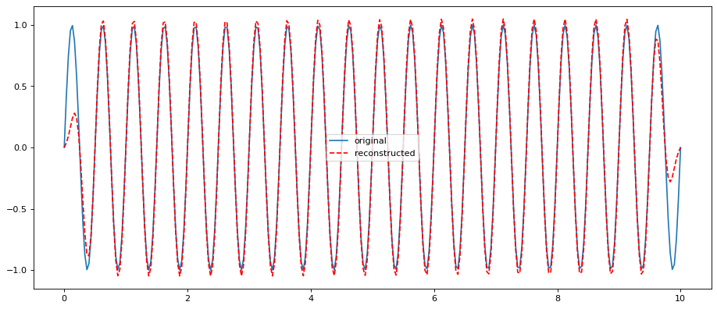
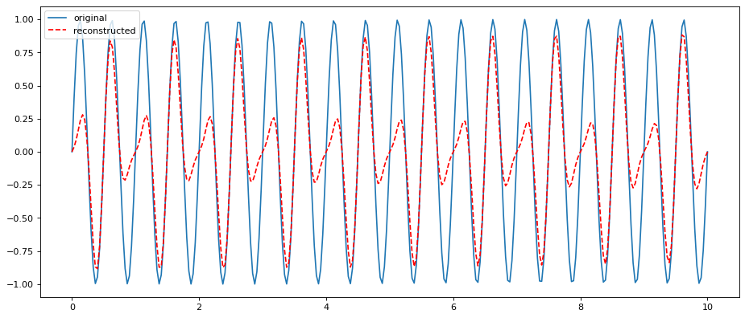
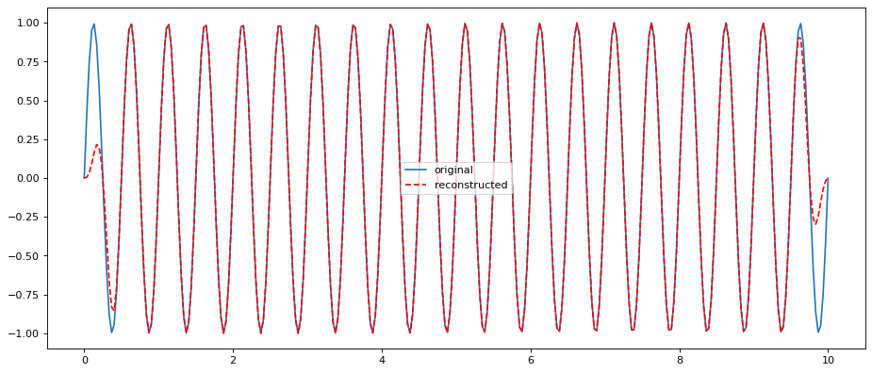
Hamming window
Hop size = window size/2
Hamming window
Hop size = window size
Hann window
Hop size = window size/2

Slide 26
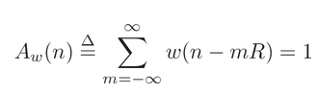
Choice of hop size
The successive frames have to overlap in time in such a way that all data are weighted equally.
R = hop size in samples
W = FFT window
Decimation by R causes aliasing.

Slide 27
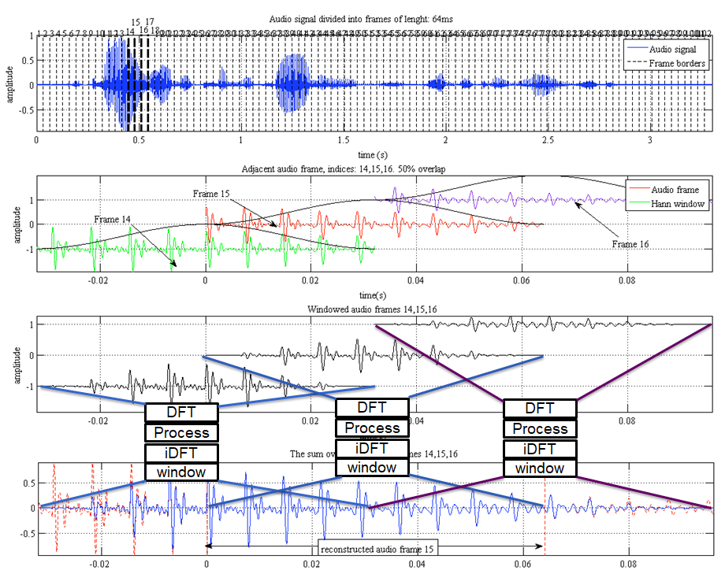

Slide 28
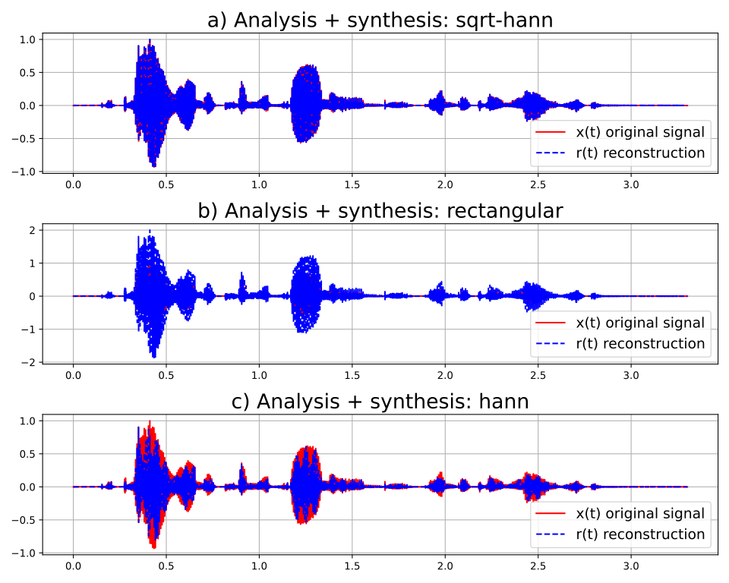
Overlap-add reconstructions
sqrt-hann in both analysis and synthesis
i.e. sin-window
rectangular in both analysis and synthesis
i.e. sin-window
hann in both analysis and synthesis

Slide 29
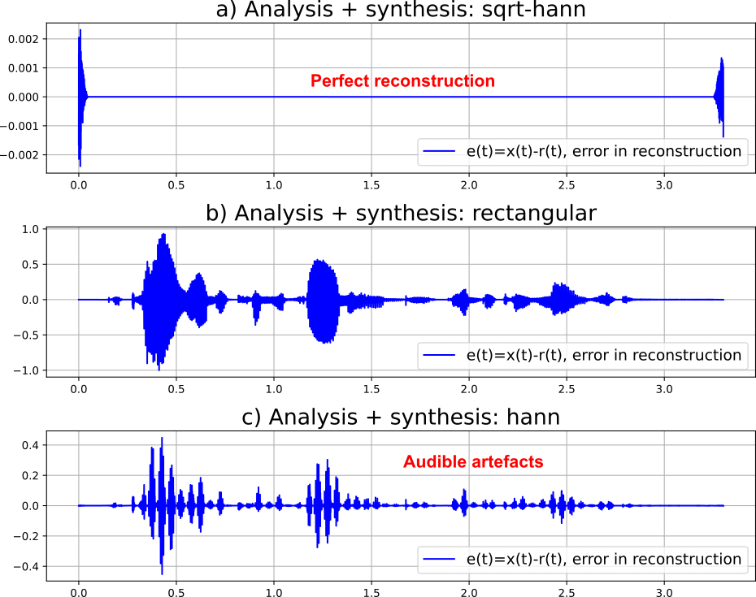
Reconstruction error
sqrt-hann in both analysis and synthesis
first+last frame see zero-padding
rectangular in both analysis and synthesis
i.e. sin-window
hann in both analysis and synthesis

Slide 30
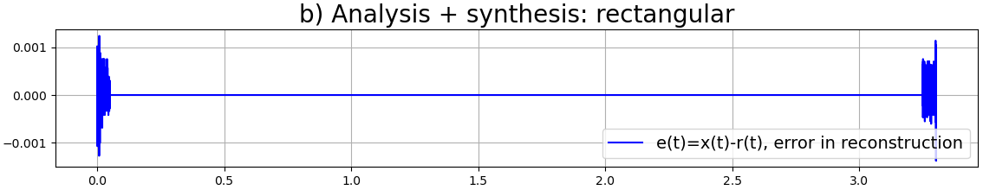
Rectangular windowing
Since w_{a}(n)*w_{s}(n)+w_{a}(n+N/2)*w_{s}(n+N/2)=1*1+1*1=2, the reconstructed signal’s amplitude is twice the original signal’s amplitude. (see figs on previous pages)
The reconstructed signal should be scaled with 0.5 to enable perfect reconstruction.
With this scaling, the reconstruction error is 0 (perfect reconstruction)
However, the spectral smearing is still present

Slide 31
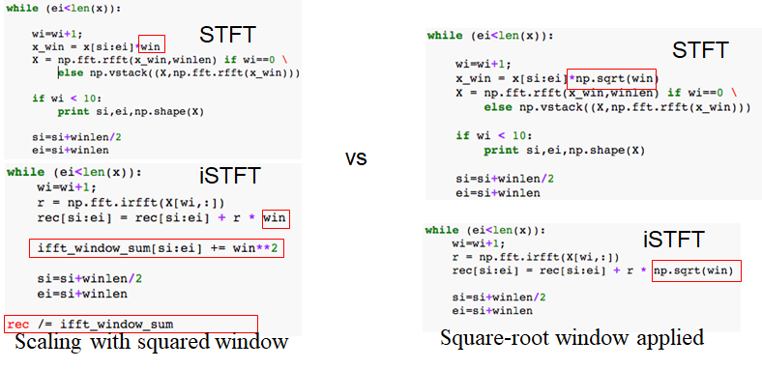
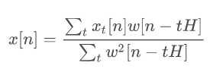
Note on implementation
Some Python implementation such as scipy.signal.stft and librosa.stft do not use sqrt(window), but instead estimate the sum of squared overlapping windows
This sum signal is used to normalize the reconstructed output signal.

Slide 32
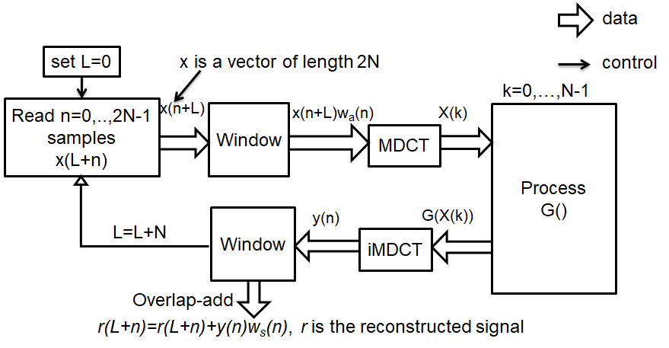
Window overlap-and-add in MDCT
MDCT processing

Slide 33
Filter bank

Slide 34
Filter Bank Models
Process the signals with a set of band-pass filters in the time domain to better emulate the frequency resolution of hearing.
Collection of filters having common input or output.
Important role in signal and image processing applications:
Audio and image coding
Splits the input signal into multiple components: Analysis
Attenuates the components differently and reconstruct them into an improved version: Synthesis

Slide 35
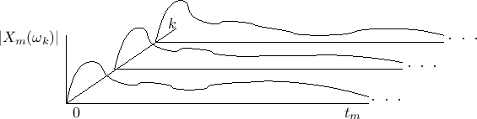
Filter-bank summation interpretation of the STFT
Overlap-add interpretation: time-ordered sequence of spectra, one per frame, with the frames overlapping in time.
FBS interpretation: frequency-ordered collection of narrow-band time-domain signals.
Uniform filter bank in which the input signal x(n) is converted to a set of N time-domain output signals, one for each channel of the filter bank.

Slide 36
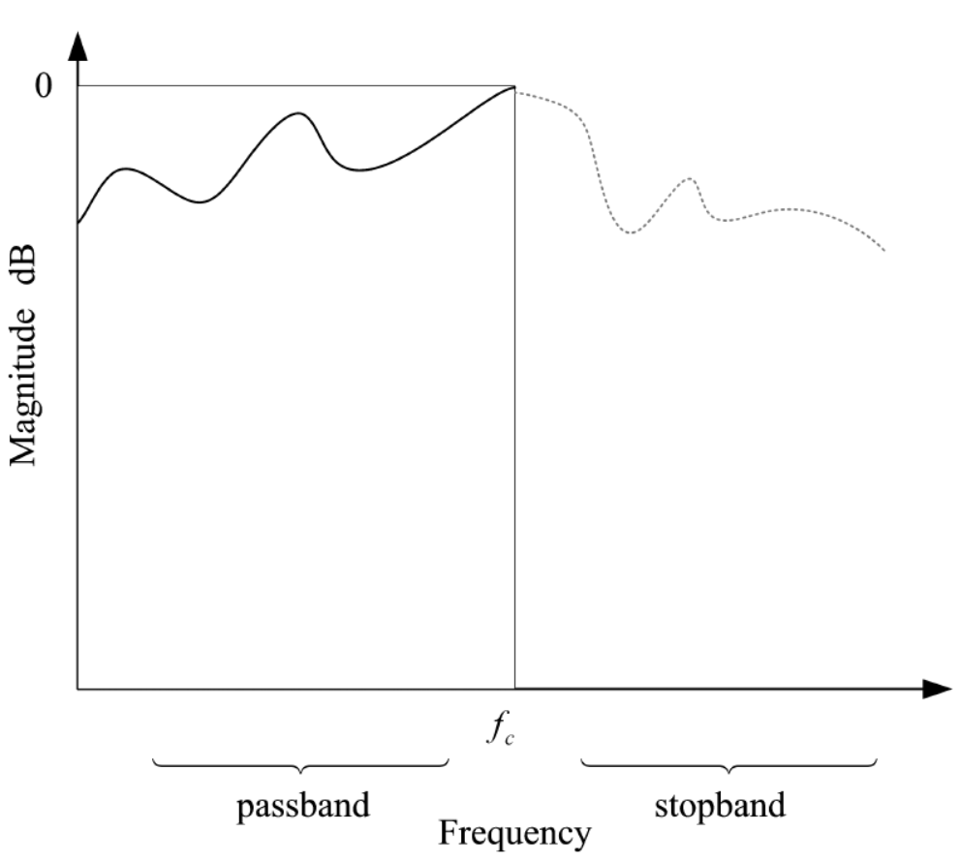
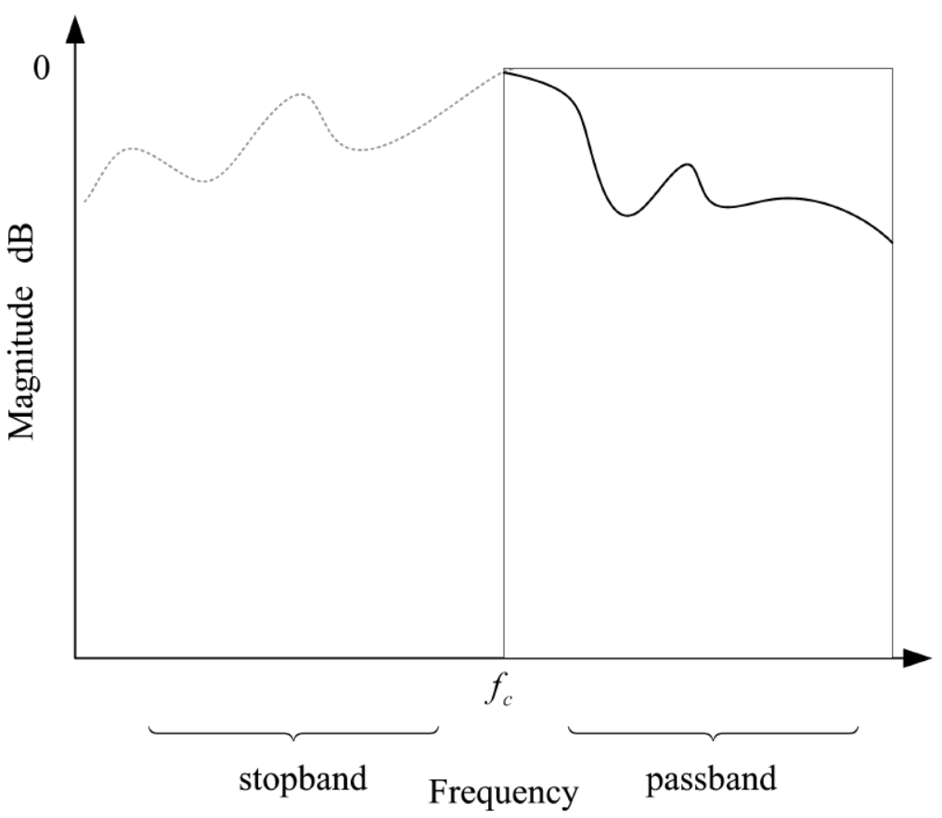
Low/high-pass Filters
Commonly found in everyday life.
In signal processing: a filter modifies the amplitude and pase components of a signal.
Ideal low-pass filter
Ideal high-pass filter

Slide 37
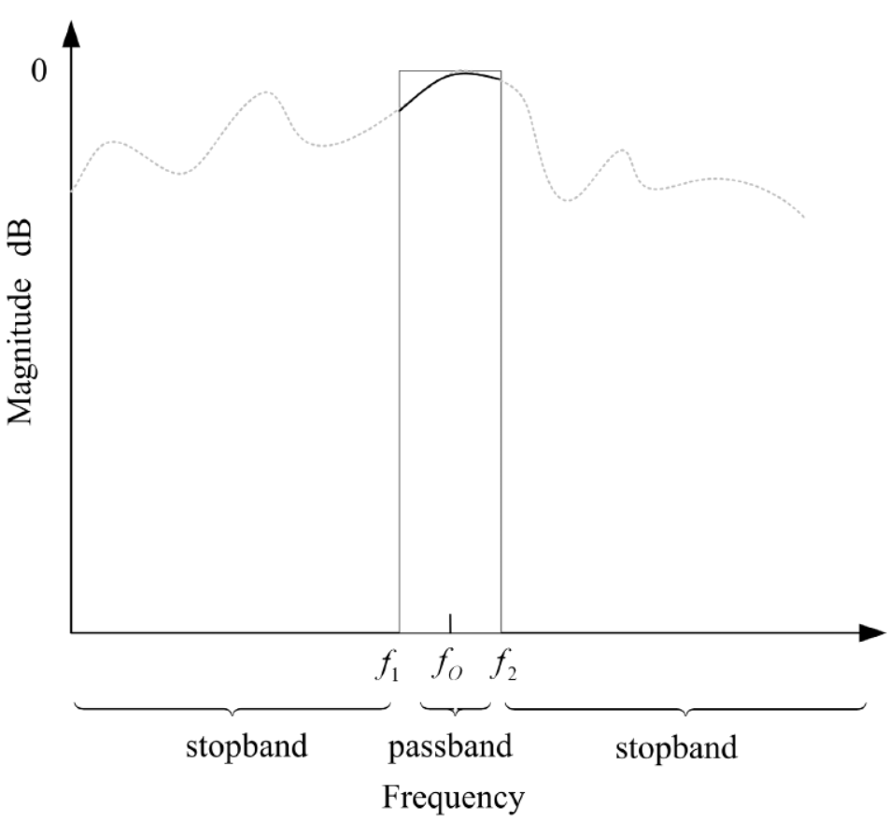
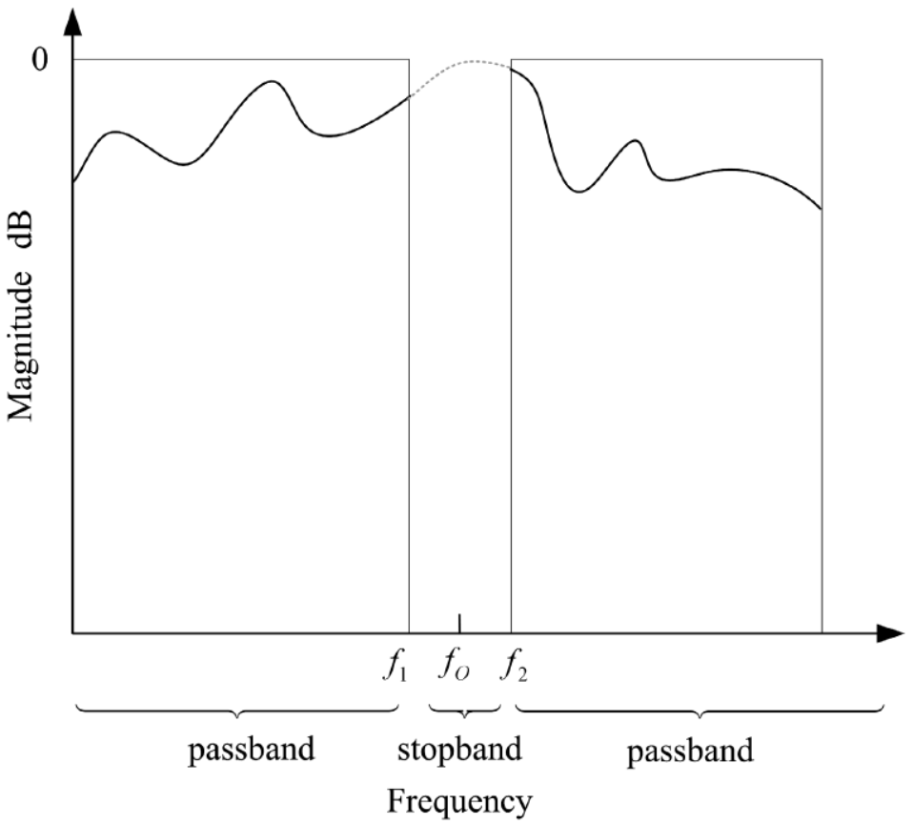

band-pass/band-stop Filters
$f_{c}$ is the cutoff frequency
Anti-aliasing filter (low-pass filter) where $f_{c}=f_{s}/2$
Ideal band-pass filter
Ideal band-stop filter

Slide 38
Passband, stopband and trasition band
Characteristic | Description
Passband | Unity gain region (ideally): 0dB or 1non-dB magnitude
Stopband | Attenuation region
Transition Band | Region between passband and stopband
Ripple | Amount of ripple tolerance allowed for filter
Filter order | Number of delay components
Cutoff frequency | Frequency that determines where the passband and stopband Will begin and end.

Slide 39

Filter sharpness and ripple
Sharpness: closeness to a brick-wall filter. The sharper the more delay components are needed (higher order filter)
Ripple: amount of wiggle in the passband region.

Slide 40

Filterbanks
Structure that mimic the critical band sctructure of the auditory filter bank. A filter bank is a parallel bank of bandpass filters covering the audio spectrum.
Transforms the broadband time-domain input signal into multiple time-domain narrowband signals.

Slide 41

Filterbanks
When used in conjunction with a perceptual model it can play an important role in the identification of perceptual irrelevancies.
The human auditory system performs frequency analysis.
Critical bands in hearing, structure of the inner ear.
One reason why we encounter filterbanks in many audio processing applications.
Applications in:
Perceptual audio coding
Multi-band equalizers
Bandwise dynamic range control
Machine hearing and audio content analysis
Signal enhancement

Slide 42
Parameters
Frequency resolution:
Low resolution filter banks (e.g. 32 subbands), often called subband coders: quantization module usually works on blocks in time direction
High frequency resolution filter banks (e.g. 512 subbands), often called transform coders: quantization module usually works by combining adjacent frequency lines (recent coders)
Mathematically, all transforms used in audio coding systems can be seen as filter banks (distinction makes no sense theoretically)
Perfect reconstruction:
Enable lossless reconstruction of the input signal in an analysis/synthesis system, if quantization is not used
Simplifies the design of the other parts of a coding system
Usually either perfect or near perfect reconstruction filter banks are used

Slide 43
Filterbank parameters
Uniform or non-uniform frequency resolution
Non-uniform frequency resolution is closer to the characteristics of the human auditory system
In practice, uniform resolution filter banks have been more successful (simplifies the coder design)
Static or adaptive
Quantization error spreads in time over the entire synthesis window
Pre-echo can be avoided if filter bank is not static but switches between different time-/frequency resolutions
Example: adaptive window switching where the system switches to a shorter window in transient-like moments of change
Prototype window (windowing of the time frame)
Especially at low bit rates, characteristics of the analysis/synthesis prototype window are a key performance factor

Slide 44



Filterbanks in use
MPEG-1 Audio prototype LP filter
A low pass prototype filter is modulated with cosine function; we obtain for each frequency band a bandpass filter
Prototype filter design is flexible
MPEG-1 audio: 511-tap prototype filter, very steep response
Reasonable trade-off between time behavior and frequency resolution
Transforms
In practice, modern encoders use MDCT as primary signal to be encoded
Window takes the part of a prototype filter, the transform modulates the filtered signal into the baseband
MPEG-2 AAC, HE-AAC, OPUS
MDCT :
Window function is constructed in such a way that it satisfies the perfect reconstruction condition:
Critical sampling and overlapping frames

Slide 45






Analysis filterbank
What happens in the analysis filterbank?
LP + 2 : Lowpass filter and downsample by factor 2
HP + 2 : Highpass filter and downsample by factor 2
When the upper half-band [fs/4 fs/2] is decimated, it is aliased (mirrored) to the lower frequencies [0 fs/4]
The aliasing does not corrupt spectral information since the lower frequency components were filtered out using a highpass filter
Upper half-band:
(a) original signal spectrum,
(b) highpass filtered (HP) spectrum
(c) highpassed and decimated (HP + 2), aliased spectrum Note the lower sampling rate in panel c): Nyquist freq.is 4 kHz

Slide 46





Synthesis filterbank
What happens in the synthesis filterbank?
￪2 + LP : Upsample by factor 2 and lowpass filter
￪2 + HP : Upsample by factor 2 and highpass filter
￪2 operation in practice:
Add zeros between the sample values in the signal (vector of numbers)
Multiply the signal by 2 in order to keep its level unchanged
Upper half-band:
(c) spectrum of the signal that was highpassed and decimated in analysis bank
(d) spectrum obtained by interpolating (￪2) signal in c
(e) after interpolating and highpass filtering (￪2 + HP) the signal in c

Slide 47

Multiple bands
The principle scales to multiple bands, each subband decimated by factor k
Critical sampling if n=k

Slide 48


Multiple bands
What happens in the analysis bank at n subbands?
Spectrum in range [0, f_{s}/2] is divided into n bands, each of width (f_{s}/2) / n
Bandpass filter H_{m}(f) in the analysis bank selects band m
Band m covers the frequencies
In downsampling, the band is aliased to frequencies
No problem, since those frequencies were filtered out by H_{m}(f)
In the synthesis bank
Interpolation by factor k (k=n) replicates the subband at all subbands
Each subband is selected at its correct frequency range using synthesis bandpass filter G_{m}(f) (same passband as H_{m}(f))

Slide 49

Aliasing error
In a critically-sampled filterbank some unwanted aliasing happens at the subbands
Filters are not ideal (transition band, not step function)
For example when downsampling by factor 2, the part that exceeds the new Nyquist frequency /2 (= fs/4) is aliased
The filterbanks used in audio coding are usually designed so that the synthesis bank eliminates the aliasing that occurs at the subbands
Achieves perfect or near-perfect reconstruction despite the unwanted aliasing at subbands
QMF = Quadrature Mirror Filter bank: designed so that the aliasing that happens in analysis part is eliminated in the synthesis part.

Slide 50


Example: Mel filter banks
Triangular filters, each having a response of 1 at the center frequency and decreaste towards 0 until reaching the center frequency of the adjacent filters.
The Mel-scale aims to mimic the non-linear human ear perception of sound.
Select the maximum and minimum frequency
Create equally spaced points
Create triangular filters
More in Lecture 10

Slide 51
Extra material
Overlap-add decomposition. Web page with examples.
https://www.dsprelated.com/freebooks/sasp/Overlap_Add_Decomposition.html

Slide 52
Summary
Steps required in transform processing: overlap processing, windowing, reconstruction
What does a filter bank do, and where it is used
Design criteria and properties of filter-banks
Transforms and filter banks are basically two views of the same thing

